Slide 1
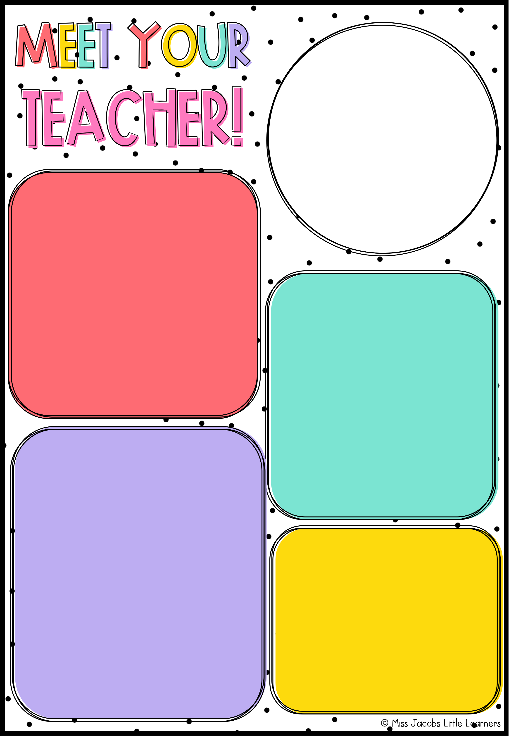
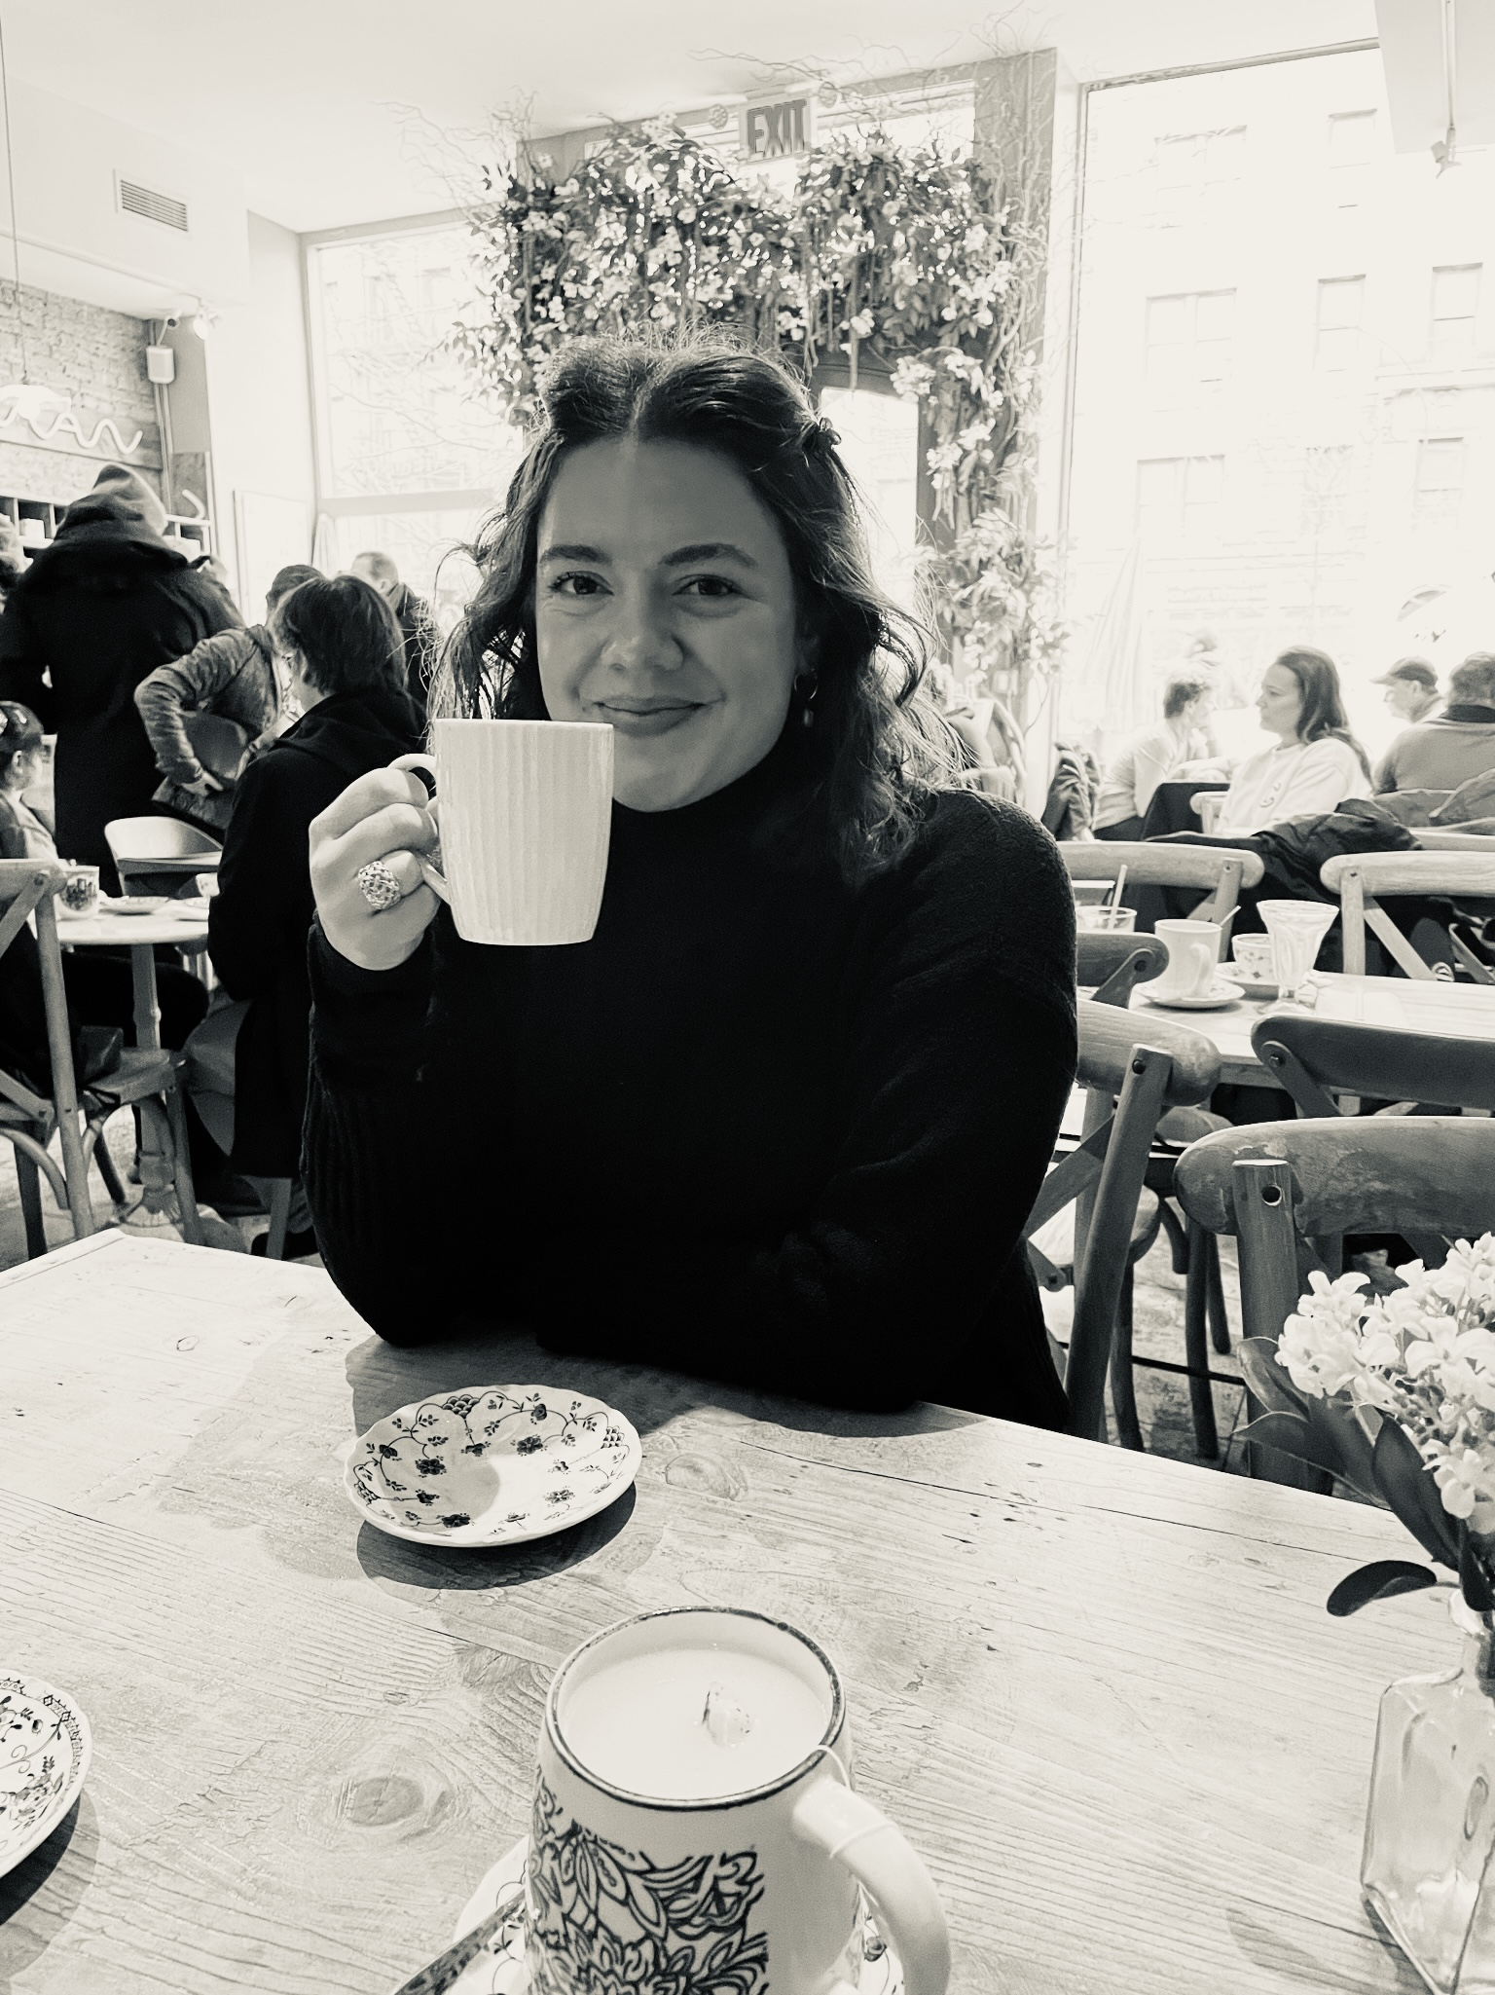
df
Hello!
Welcome to the 2024-2025 school year! I am your teacher, Ms. Moccia. This is my 6th year teaching and 5th year at Pick. I am excited to start this new adventure with you! 3rd grade will be filled with fun activities and new concepts. You will learn so many new skills! I can’t wait to watch our class family grow and see how much you achieve. You will do great things and I will help you have a blast along the way.
Education
Bachelor’s Degree in Elementary Education
Master’s Degree in Elementary Education
Administration and Leadership Certification
Favorite
Candy: Sweet Tart Mini Chewy
Drink: Iced Coffee
Color: Light Blue
Movie: Secret Life of Pets
Hobbies: When I am away from schoolwork, I enjoy spending time with friends and family, reading my favorite books, playing with my cat Murphy and large mugs of coffee!
Contact Me
Skmoccia@auburnschools.org
334-887-2100
1320 N College St, Auburn, AL 36830

